Slide 1
Notes:
Room Holding Slide during registration

Slide 2
Lesley Harrison
Head of Charitable Services
Autism Jersey
Notes:
Brief introduction from Lesley – Head of Charitable Services, and with the support of the AJ Team, Co Ordinator of today’s event

Slide 3
Welcome
The Autistic Experience and Voice
Supporting a Neurodiverse Strategy for Jersey
Notes:
Lesley: Welcome – H&S housekeeping / Autism friendly event – ‘interaction badges’ / ‘Quiet Room facilities’ ‘ no clapping but hand waving’ Jazz hands!

Slide 4
Aims & Objectives
To hold an Interactive Workshop where voices are heard
Co Creating to identify needs linked to identified themes
Explore themes and look to align to what is needed for delivery from key stakeholders
Co creating an Action plan that can align to the strategy for Jersey
Provide substantial information that will enable and build into the overarching GoJ Strategies
Overall aim is to deliver positive outcomes for autistic individuals in Jersey
Notes:
Lesley: Aim and objectives of the day:
Last year independent research commissioned by Autism Jersey in partnership with GoJ – the highlights of this research will shortly be presented by Prof. Richard Mills of AT- Autism, London.
As a follow up, this interactive workshop today will be independently facilitated by Sarah Martin – Development Director of the Wellbeing Collective, London.
Group work – to capture your voice / experience / action planning - under the direction of Sarah, you will rotate in your Group to contribute to each theme – of which there are 8
Introduce Sarah as facilitator

Slide 5
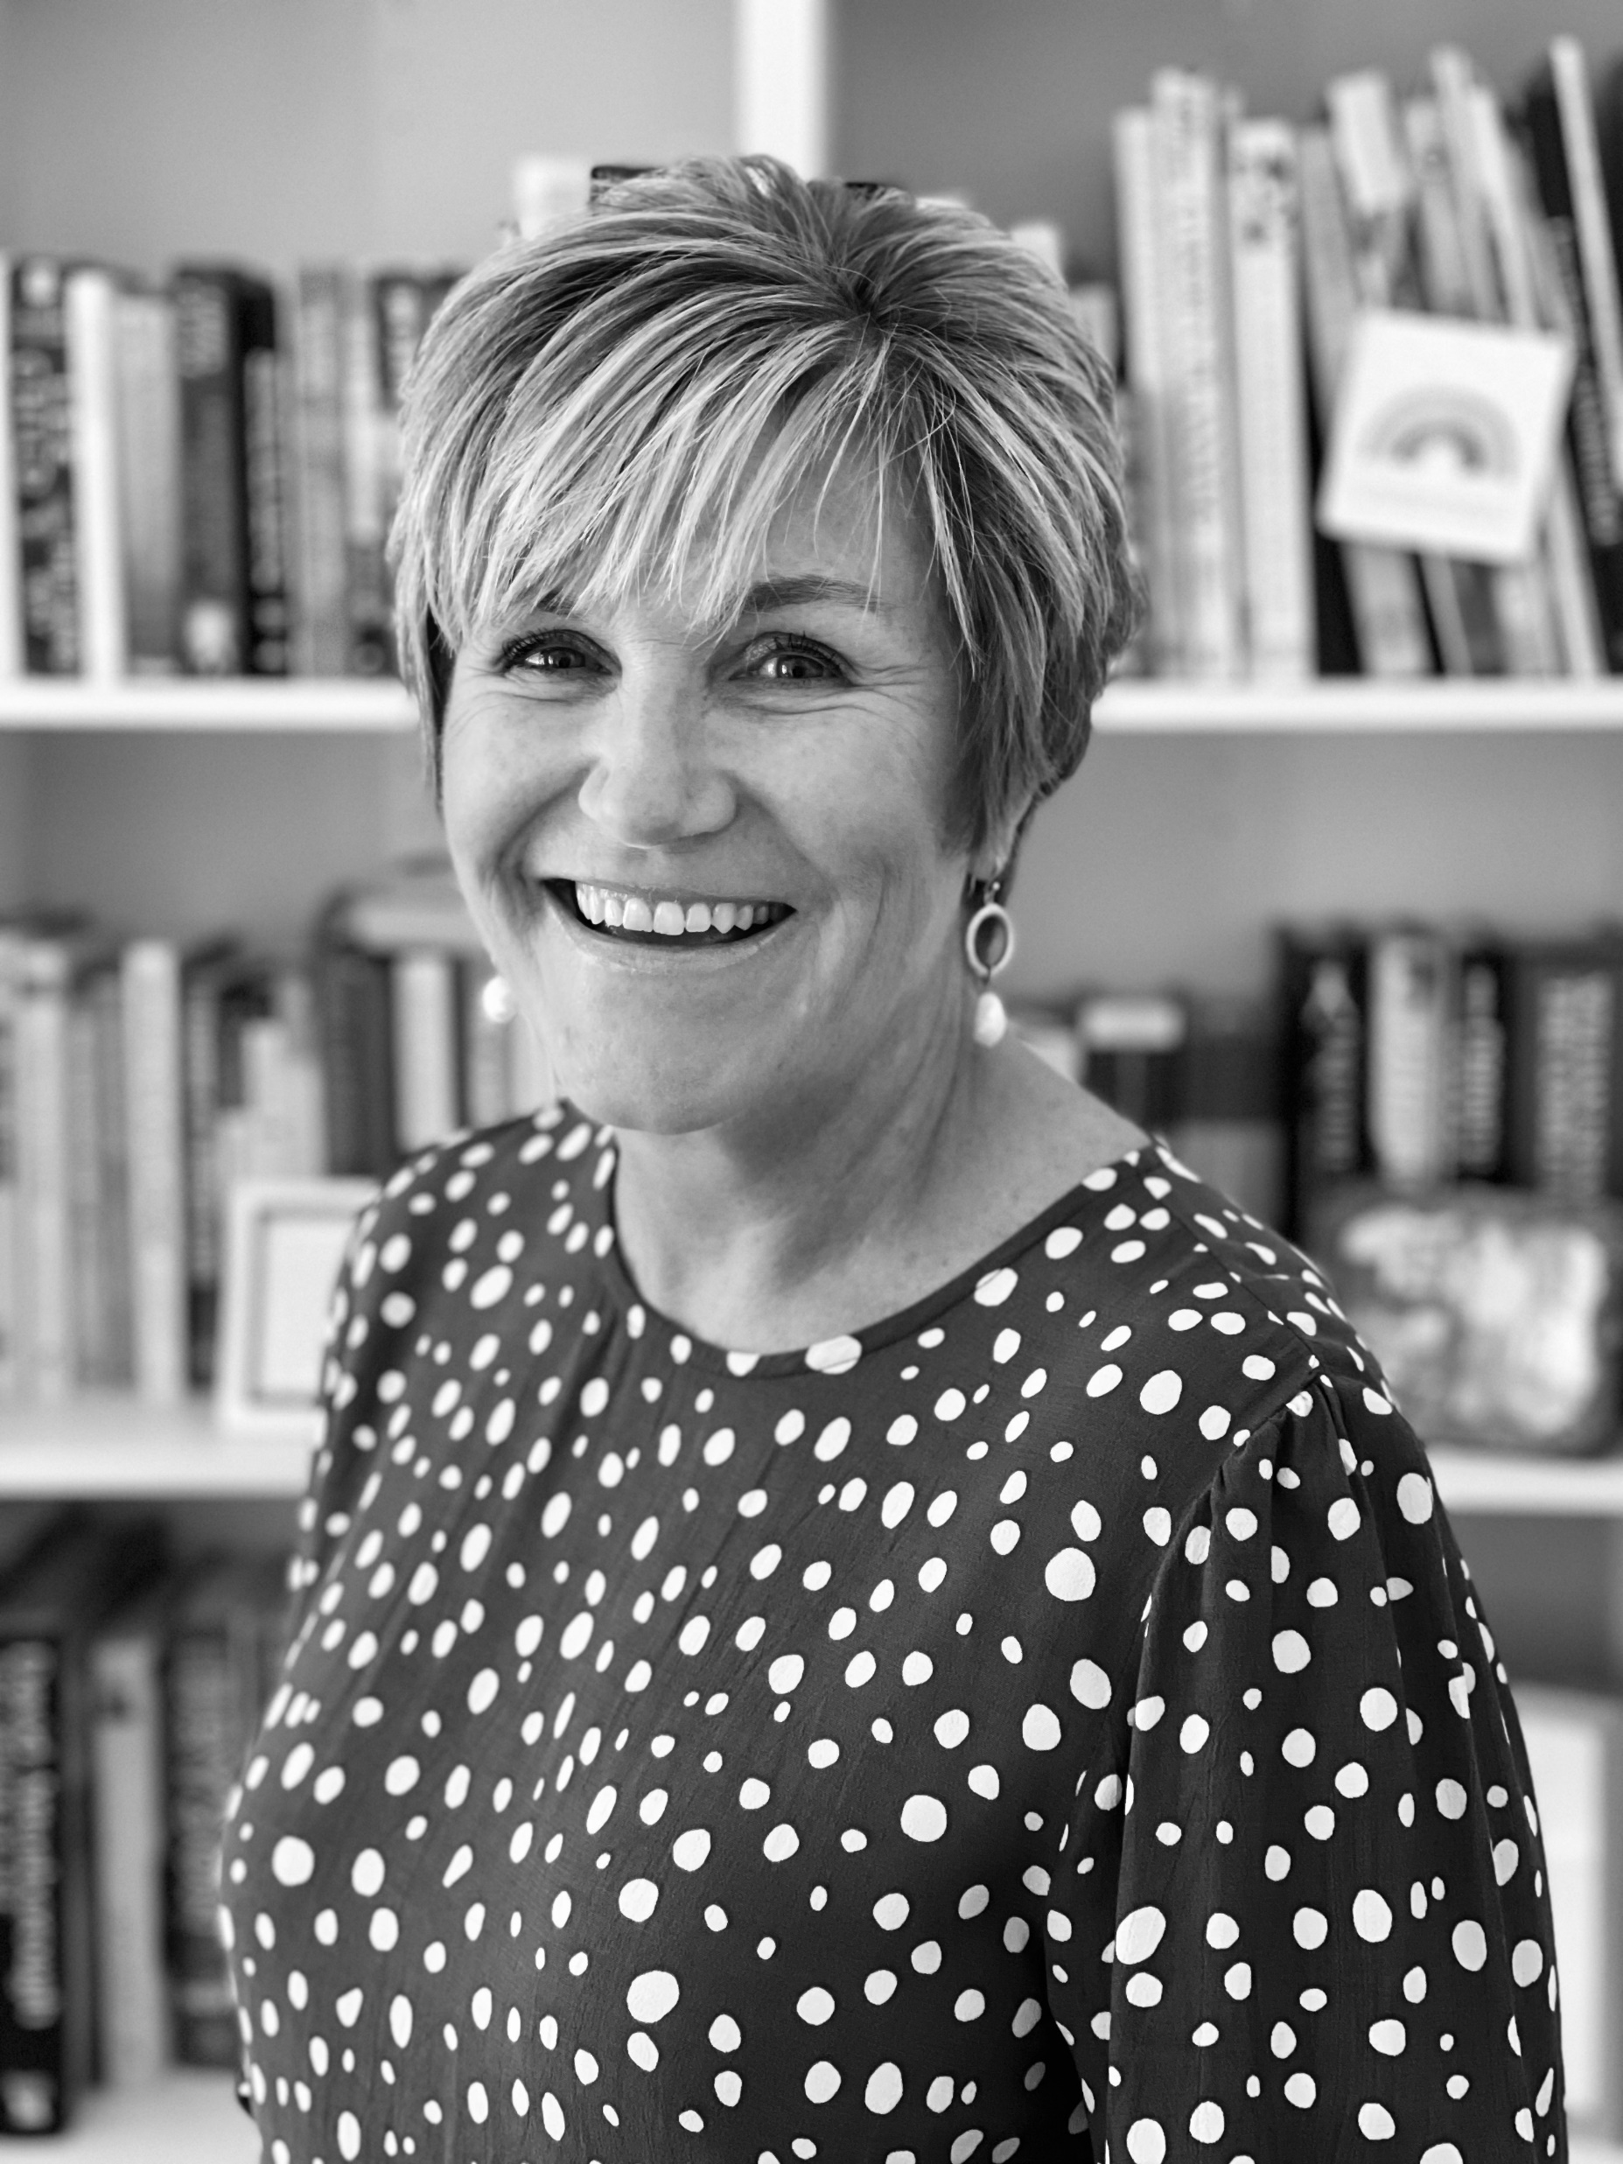
Sarah Martin
Development Director with Wellbeing Collective Ltd
Over 18 years in healthcare and working alongside Voluntary sector in operational, managerial and director roles plus 18 years in private sector in retail
The Wellbeing Collective is an independent consultancy with strong ethics and values that help individuals, organisations and communities grow in confidence, competence and creativity
Great privilege to be your facilitator to help you shape the way forward
Notes:
Sarah Martin
Organisational Development Director with Wellbeing Collective Ltd
Over 17 years in healthcare and working alongside Voluntary sector in operational, managerial and director roles
The Wellbeing Collective is a company made up of talented people, driven by our ethics and values, with an aim to help individuals, organisations and communities grow their confidence, competence and creativity
It is such a pleasure to be your facilitator today. My sister and her family have lived in Jersey for over 35 years and I visit several times a year and to be here with you all, supporting you today is a real privilege

Slide 6
How we might want to be today
We have a lot to talk about and communication works best when we listen and give everyone a voice
We all benefits from kindness and supporting each other
Celebrating our similarities and differences to create possibilities
Notes:
Part of the Wellbeing collective is to always value the differences and similarities in a room and for us we believe that when we gather people together in a group or as a large gathering that we consider
Our communications – we will all be passionate about how we bring the strategy to life and we will all have opinions and want to be heard – we want to ensure that everyone has a voice
We believe that every one benefits from kindness so we advocate being supportive to each other
We believe that anything is possible and its good for us to all celebrate our similarities and differences and create possibilities

Slide 7
Time | Activity
09:30 – 9.45 | Welcome & Aims/Objectives & Who is in the room ?
9.45 – 10.45 | Richard Mills – overview of research
10.45 – 11.00 | Tea/ Coffee / Comfort Break
11:00 – 13.00 | Action Planning through rotation
13.00 – 14.00 | Lunch
14.00 – 14.45 | Walking the Wall - where will the most impact be and when ?
14.45 – 15.00 | Tea / Coffee / Comfort Break
15.15- 15.40 | Ask the Panel
15.40 – 15.50 | Summary & Close
Notes:
Sarah

Slide 8
Who is in the room ?
On your tables each person
Share your name
What do you do ( Government, Parent, Carer, work for a caring organisation or other) ?
Why you are here today ?
Each table has 10 minutes to do the introductions
Notes:
Sarah: Note: 8 tables are part of the interactive workshop – each table with their theme. Table 9: is the late table for Ministers arriving at lunchtime so they also have time to ‘walk the wall’

Slide 9
Introducing Professor Richard Mills
Associate Consultant and Advisor to the board of AT-Autism
Notes:
Sarah

Slide 10
Neurodiversity
What is it and how do we refer to it ?
Notes:
Richard:

Slide 11
Getting the language right Terminology -Neurodiversity= everyone in society (no ‘one brain’) -Autistic children, not children with autism - People are autistic – they do not have autism
Notes:
Richard

Slide 12
Autism
One of a group of neurodivergent conditions (with ADHD/ADD, Dyslexia, Dyspraxia, Tourette syndrome, Dyscalculia)
As autism is a small group within the neurodivergent population it is sometimes referred to as a neurominority
Notes:
Richard

Slide 13
Neurodivergent conditions: prevalence in workforce: Source: Institute of Leadership and Management 2020
ADHD/ADD
4%
AUTISM/ASD 2%
DYSCALCULIA
7%
DYSLEXIA
10%
TOURETTE SYNDROME
1%
DYSPRAXIA
5%
Notes:
Richard:

Slide 14
Summary of public consultation
Overview and priorities
Richard Mills
November 2022
Notes:
Richard

Slide 15
Commissioned by Autism Jersey and the Government of Jersey
Independently facilitated and conducted by AT-Autism

Slide 16
Responses (n.215): Via local media
23% autistic
60% families
36% professionals
21% public
5% employer
Anonymous data provided to AT-Autism via confidential online survey
Confidence Level 95%, Margin of Error 7%
Responses contained unusually rich level of detail for qualitative analysis (reported)

Slide 17
Summary of population survey
Questions devised through a DELPHI process
Survey September 2021
Questions on current state and on priorities

Slide 18
Respondent profile
Notes:
Richard – is this too much on one slide for the audience to read ? Does it need to be across 2 slides?

Slide 19
Questions responses
Notes:
Richard

Slide 20
20% strongly agree or agree
59% disagree or strongly disagree

Slide 21
14% strongly agree or agree
55% disagree or strongly disagree

Slide 22
19 % strongly agree or agree
38% disagree or strongly disagree

Slide 23
14% strongly agree or agree
58% disagree or strongly disagree

Slide 24
35% strongly agree or agree
27% disagree or strongly disagree

Slide 25
2% strongly agree or agree
92% disagree or strongly disagree

Slide 26
14 % strongly agree or agree
63% disagree or strongly disagree

Slide 27
18 % strongly agree or agree
48% disagree or strongly disagree

Slide 28
17 % strongly agree or agree
40% disagree or strongly disagree

Slide 29
23 % strongly agree or agree
57% disagree or strongly disagree

Slide 30
11 % strongly agree or agree
42% disagree or strongly disagree

Slide 31
13% strongly agree or agree
51% disagree or strongly disagree

Slide 32
28 % strongly agree or agree
53% disagree or strongly disagree

Slide 33
13 % strongly agree or agree
33% disagree or strongly disagree

Slide 34
8% strongly agree or agree
20% disagree or strongly disagree

Slide 35
7 % strongly agree or agree
54% disagree or strongly disagree

Slide 36
18 % strongly agree or agree
44% disagree or strongly disagree

Slide 37
13 % strongly agree or agree
57% disagree or strongly disagree

Slide 38
30 % strongly agree or agree
43% disagree or strongly disagree

Slide 39
25 % strongly agree or agree
53% disagree or strongly disagree

Slide 40
20 % strongly agree or agree
48% disagree or strongly disagree

Slide 41
Population survey to inform the strategy
Delphi methodology - questions devised by an expert group, comprising autistic people, families, and professionals 2020 -2021
Examples of excellent practice and services reported but not widespread
Awareness and understanding described as ‘patchy’
Barriers remain to employment
Progress noted in some areas (e.g., autistic presence, transport, and effectiveness of SPELL training ) but significant unmet need (Diagnosis, equality, education,, mental health, and family support)
Concern that some areas had regressed (e.g. Education and on-island capacity)

Slide 42
Coffee Break
Notes:
During coffee, use this time to network amongst yourselves and talk about your actions
Ask person who is scribing to be as neat as possible and that is it easy to read – no half finished sentence and neat and fine.
VIP: Please ensure that each flipchart page used has the theme title and Group number at the top of it….eg: Education G1.

Slide 43
Priorities

Slide 44
Rotational Action Planning
With the priorities
Notes:
Share with group –
we have an ambitious session ahead and we need to work at pace
On tables, strategy –
Today is moving to next level of implementing the strategy and writing our action plan– we know that when people are involved in creating actions that they are more likely to be implemented
Your first action is to chose someone on your table that is good at writing – You can change over regularly so don’t think you will be stuck with the pen all day
Your will find – on each table, there is
Large Flip chart paper with one of the eight identified priority areas
Pens
Space to write
Strategy
List of the aims under the priorities

Slide 45
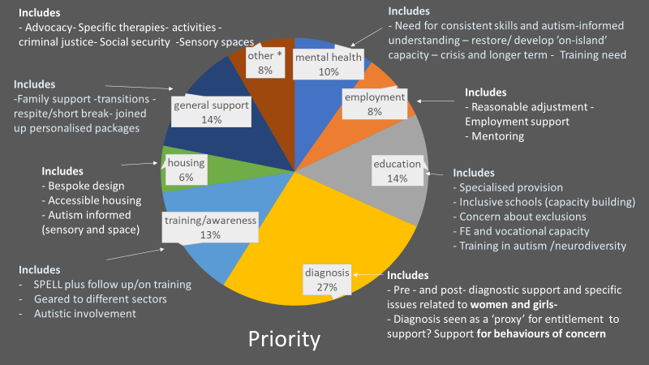

Slide 46
Eight Priorities identified were:
Mental health – consistent skills & focused understanding
Employment – reasonable adjustments / work programmes
Education – Specialised provision and capacity building
Diagnosis – Pre & post diagnostic support
Training & Awareness – SPELL / Public, Private, Third Sector
Housing – Accessibility
General Support – Respite & family
Other - therapies & activities, Criminal Justice System, Social
Security etc
Notes:
So remind us we have
These are the 8 priorities identified last year from the research

Slide 47
Every table takes a priority and its aims and look to gather as many actions as possible
Rotational Action Planning
First chose someone on your table to write on the flipchart paper ( so that its easy to read for others)
Each table has roughly 20 minutes for the priority that is on their table now.
Discuss as a table, the first thoughts that you can think of for the priority. For example, Employment might be about mentorship ?
Facilitators to write down :-
What is needed to make the priority become a reality – the HOW – the ACTIONS
State who is needed to make this priority happen – the WHO
Notes:
READ above
I will leave the slide up so you know what to do
Whoever is scribing – my only ask is for it to be as neat as possible and that is it easy to read – no half finished sentence and neat and fine. This will help me when I type up your action plan
And please ensure that each flipchart page your individual group writes up has the theme heading and Group number on it…eg: Education G1
This is why we are doing this

Slide 48
Control & Influence
Notes:
In your strategy you have some areas that you might not have full control over
Let me explain
There are some things that you can control in your strategy and influence and there are some things that you cant control but can influence for example legislation for example.
You can influence it but not always control it as in its timing etc
So when you are looking at creating the action or the HOW are we going to do this, remember what you can control and influence– bear this in mind

Slide 49
Go round again…
We are going to do this 8 times……
This time 15 minutes with a new priority
Chose someone on your table to write on the flipchart paper ( so that its easy to read for others)
Each table has roughly 15 minutes for the priority that is on their table now.
Discuss as a table, the first thoughts that you can think of for the priority. For example, Employment might be about mentorship ?
Facilitators to write down :-
What is needed to make the priority become a reality – the HOW – the ACTIONS
State who is needed to make this priority happen – the WHO
Notes:
Sarah

Slide 50
Sharing our actions
Notes:
If we have time before lunch to discuss
Praise work done
We now have actions
The question is can we do these actions listed and are they clear – we need to make sure that we have broken down our actions
What is important is for us to consider what do we need in order to make it happen – the who or the resources or the organizations ? Have we listed these ? Are there potential challenges for our actions too ?
Is there anything missing now that we have created the actions ?

Slide 51
Lunch
Notes:
Whilst you are at lunch – we will be putting the actions up around the room

Slide 52
Everyone has contributed to the eight priorities – you have co- created the high level action plan for a strategy for autism in Jersey
Mental health – consistent skills & focused understanding
Employment – reasonable adjustments / work programmes
Education – Specialised provision and capacity building
Diagnosis – Pre & post diagnostic support
Training & Awareness – SPELL/Public, Private, Third Sector
Housing – Accessibility
General Support – Respite & family
Other - therapies & activities, Criminal Justice
System, Social Security
Notes:
WELCOME BACK
Quick energiser after lunch– possibly – sit and stand and turn around again or round of ‘hand waving’ ( no applause as autism friendly event) for themselves for what they have achieved so far.
Jazz hands – ask how the morning was – jazz hands up here if going well, in the middle if ok but lets see and then not going well down here…. Physically energised.
These are the eight priorities that were identified 2021 research

Slide 53
Shaping our action plan into years
“when do we do it ?”
Notes:
Sarah

Slide 54
Each table to determine when we deliver the actions …..
Walk the Wall
Using the dots (9 in total) you have place them according to the following :-
Green dot for 1st year action
Amber dot for 2nd year action
Red dot of 3rd year action
Notes:
Discussing as a group going around the wall together, you need to determine what we do when – don’t put the dot on until they have discussed this – group decisions
Taking the different colour dots you have, place them onto the actions as follows
Each table has 9 dots each – 3 green, 3 amber and 3 red
Using the dots you have place :-
Green dot for 1st year action ( Green for Year 1 action)
Amber dot for 2nd year action
red dot of 3rd year action
You are identifying what is achievable in the next 36 months breaking it into years. Where do you want immediate delivery of something in 2023- say your quick wins ,
Where are your actions for the second year – the ones that might take a bit of working through to get there in 2024
And where are the longer term, bigger projects to achieve in year 3 – 2025

Slide 55
Tea break

Slide 56
Ask the Panel
Notes:
Sarah;
Introduce: Professor Richard Mills – AT- Autism London and Will Lakeman – Chair GoJ Neurodiversity Network
Sarah: Myself and Chris Dunne, AJ CEO will each have a roving mic and divide up the room between us.

Slide 57
Panel Members
Professor Richard Mills AT-Autism London
Will Lakeman Chair GoJ Neurodiversity Network
Clare Ryder Head of Community Mental Health
Notes:
Sarah;
Introduce: Professor Richard Mills – AT- Autism London and Will Lakeman – Chair GoJ Neurodiversity Network
Sarah: Myself and Chris Dunne, AJ CEO will each have a roving mic and divide up the room between us for Q&A

Slide 58
Where do we go from here?
Sarah Martin & Lesley Harrison
Notes:
Sarah: Feedback on engagement / creating solutions / positive action planning taken place today etc.
Lesley: Where do we go from here…..
Collaboration/ partnership approach – creating solutions to provide positive outcomes – a community working together
Collation of today’s work to develop the action plan by Autism Jersey.
Formation of a working party of identified key stakeholders with ownership for delivery – to discuss, agree and formulate delivery milestones
Basis to feed into GoJ overarching strategies and also community strategies - to deliver positive outcomes for autistic individuals.
Lesley to hand over to Chris Dunne CEO AJ to give formal thanks and bring proceedings to a close.

Slide 59
Chris Dunne
Chief Executive Officer
Autism Jersey
Notes:
Chris:
Couple of lines on the interactivity of the delegates – how pleasing to see a respectful collaborative approach
Formal Thank you to: Sarah Martin – our independent Facilitator from the Wellbeing Collective London and Prof. Richard Mills from AT- Autism London and Will Lakeman, Chair of the GoJ Neurodiversity Network.
Thank you to all those hard working people behind the scenes to get us to this stage today – which includes parents / carers at home, those in the community from the public, private and third sector, and at the coal face who where each and everyone are committed and dedicated to delivering positive outcomes and making a difference to autistic individuals lives – and finally THANK YOU, for participating to today’s important workshop and we genuinely look forward to collectively delivering that much needed action plan that will support a strategy for autism in jersey.
Chris, we need to close firmly at 16:00hrs !

